Slide 1

NCAR Celebrates
Unidata’s
25th Anniversary
Eric Barron
NCAR Director
October 16, 2009

Slide 2
NCAR’s Mission
To understand the behavior of the atmosphere and related physical, biological and social systems
To support, enhance and extend the capabilities of the university community and the broader scientific community, nationally and internationally
To foster the transfer of knowledge and technology for the betterment of life on Earth
  …Unidata is a critical component in ensuring that NCAR achieves this mission.

Slide 3
NCAR’s Four Focus Areas
Computing capabilities and data delivery
Developing/deploying scientific tools and services
Advancing Earth-system science
Technology transfer for societal benefit

Slide 4
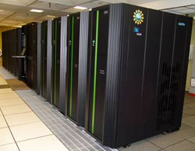
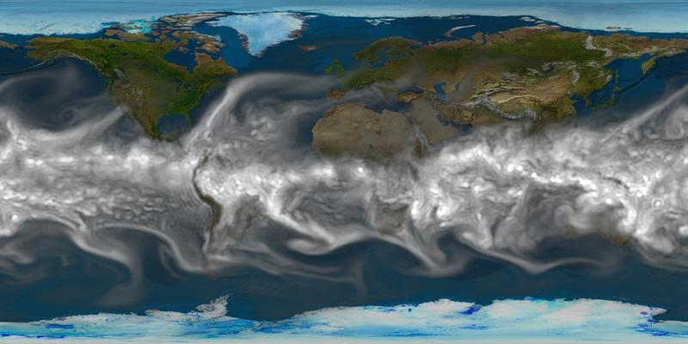
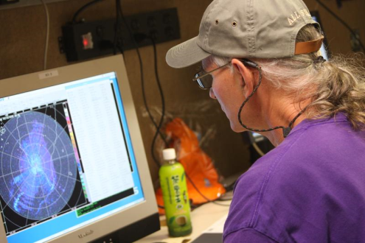
Computing capabilities and data delivery
NCAR’s Computational and Information Systems Laboratory (CISL) and Unidata work together to provide our science community with tools that facilitate data …
Access and management
Visualization
Integration and analysis
… in a robust cyberinfrastructure
NCAR’s Four Focus Areas:
Computing Capabilities & Data Delivery

Slide 5
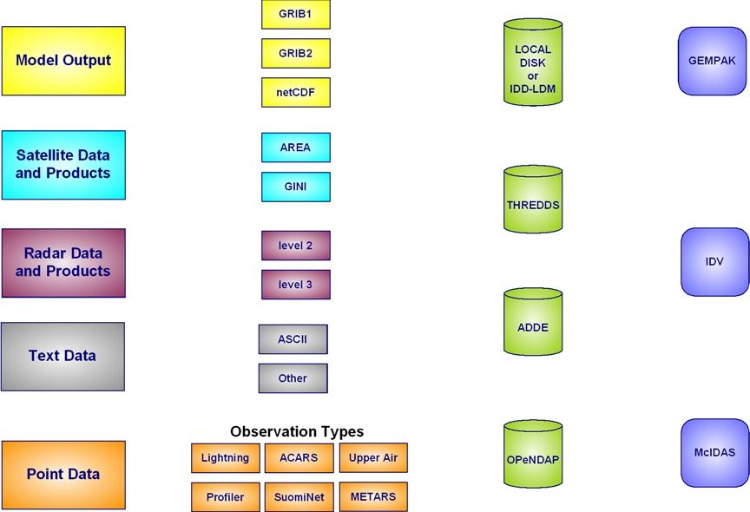
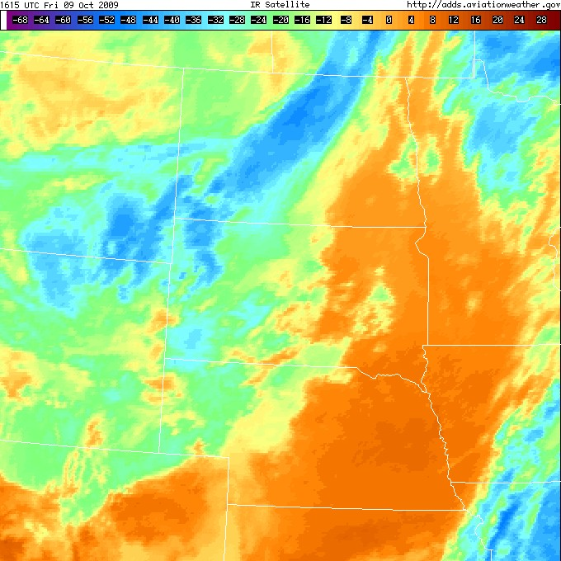
Data Access & Management
From satellite and GIS data, to radar imagery, observations, and model output, the international research community can access data through NCAR’s Community Data Portal (CDP).
Run by CISL, the CDP relies on many Unidata software technologies (e.g., netCDF, Local Data Manager, and Thematic Realtime Environmental Distributed Data Services) to meet user access and management requirements.
NCAR’s Four Focus Areas:
Computing Capabilities & Data Delivery
Notes:
The CDP grew out of a pilot project between what was then known as NCAR’s Scientific Computing Division (SCD) and Unidata. Project funding came from the NCAR Director's Opportunity Fund about 10 years ago.

Slide 6
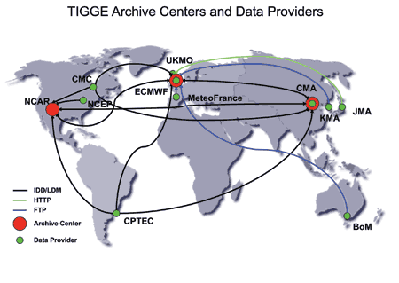
Data Access & Management
CISL and Unidata staff worked closely to move data collected as part of the THORPEX Interactive Global Grand Ensemble (TIGGE) from the projects’ 10 global Numerical Weather Prediction centers to the three data archival centers at NCAR, ECMWF, and the Chinese Meteorological Administration.
NCAR’s Four Focus Areas:
Computing Capabilities & Data Delivery
Notes:
Project Background: The THORPEX Interactive Grand Global Ensemble (TIGGE) is a key component the World Weather Research Program, THORPEX, which aims to accelerate improvements in the accuracy of 1-day to 2-week high-impact weather forecasts for the benefit of humanity. NCAR is one of TIGGE’s three major data portals. Unidata and CISL work closely to ensure that TIGGE researchers can access TIGGE data. The Unidata Internet Data Distribution (IDD) system is used to transport the ensemble model data from the providers to the archive centers and between the archive centers. This work began in 2006 and continues today, running 24x7.
Key Message: TIGGE decided to use Unidata's Local Data Manager (LDM) to move data in real time from those centers to the three data archival centers at NCAR, ECMWF, and CMA (Beijing). It involves transferring very large amounts of data - 88 TB/yr, which averages out more than 10 GB/hour, with an 18 GB/hour transfer rate occurring at peak performance. Unidata worked closely with CISL in enhancing the LDM to meet TIGGE data flow needs and helped CISL to establish the TIGGE data portal at NCAR.

Slide 7
TIGGE
The Unidata Internet Data Distribution (IDD) system is used to transport the ensemble model data from the providers to the archive centers and between the archive centers. This work began in 2006 and continues today, running 24x7.
Unidata's Local Data Manager (LDM) moves data in real time to the three data archival centers at NCAR, ECMWF, and CMA (Beijing). 88 TB/yr, which averages out more than 10 GB/hour, with an 18 GB/hour transfer rate occurring at peak performance.
Unidata worked closely with CISL in enhancing the LDM to meet TIGGE data flow needs and helped CISL to establish the TIGGE data portal at NCAR.
Notes:
The Unidata Internet Data Distribution (IDD) system is used to transport the ensemble model data from the providers to the archive centers and between the archive centers. This work began in 2006 and continues today, running 24x7.
TIGGE decided to use Unidata's Local Data Manager (LDM) to move data in real time from those centers to the three data archival centers at NCAR, ECMWF, and CMA (Beijing). It involves transferring very large amounts of data - 88 TB/yr, which averages out more than 10 GB/hour, with an 18 GB/hour transfer rate occurring at peak performance. Unidata worked closely with CISL in enhancing the LDM to meet TIGGE data flow needs and helped CISL to establish the TIGGE data portal at NCAR.

Slide 8
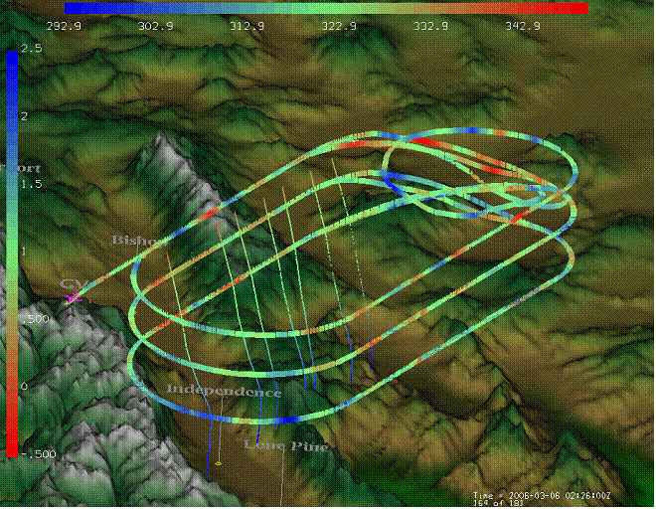
Data Visualization, Integration & Analysis
Making data as functional as possible is a service NCAR offers our science community. Unidata software (e.g., Integrated Data Viewer, GEneral Meteorology PAcKage) helps researchers view critical geophysical phenomena in multiple dimensions, allows them to mix and match data sets, and aids data exploration that sheds insights on the Earth system.
An IDV image shows the GV’s track during T-REX, as well as dropsonde observations, which are color coded by temperature.
NCAR’s Four Focus Areas:
Computing Capabilities & Data Delivery

Slide 9
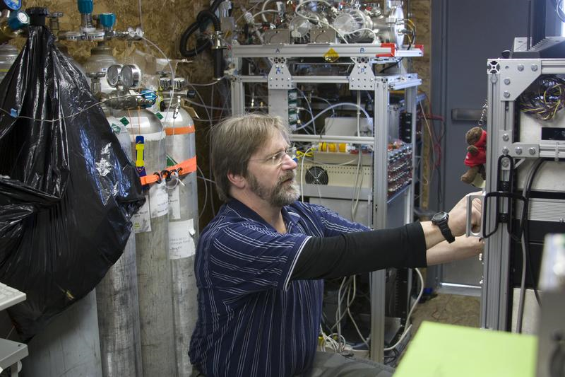
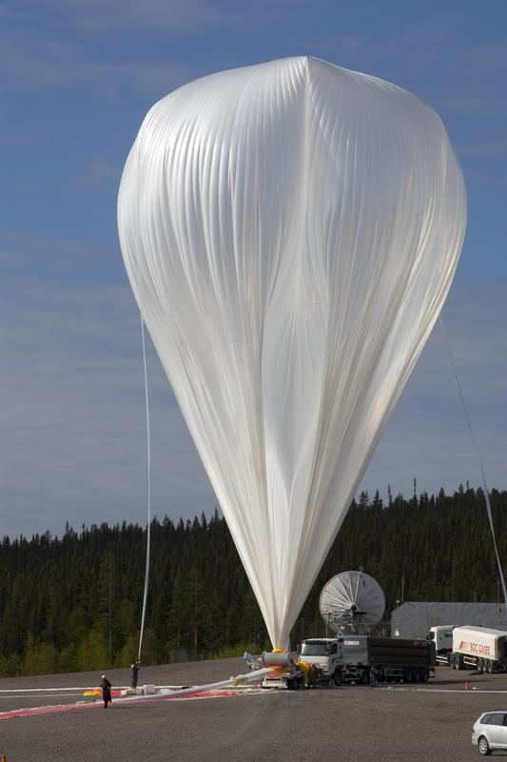
Scientific Tools & Services
NCAR’s Earth Observing Laboratory (EOL) and Unidata work closely to ensure field-project data are quickly and easily accessible to users via tools such as the Integrated Data Viewer, Local Data Manager, and Thematic Realtime Environmental Distributed Data Services.
EOL and Unidata are united in bringing together a Virtual Operation Center that offers support during and subsequent to field campaigns.
NCAR’s Four Focus Areas:
Developing/Deploying Scientific Tools & Services
Notes:
Among the recent field project collaborations between EOL and Unidata are the Airborne Carbon in Mountains Experiment (ACME), the Terrain-induced Rotor Experiment (T-REX), and the Rain In Cumulus over the Ocean (RICO) experiment

Slide 10
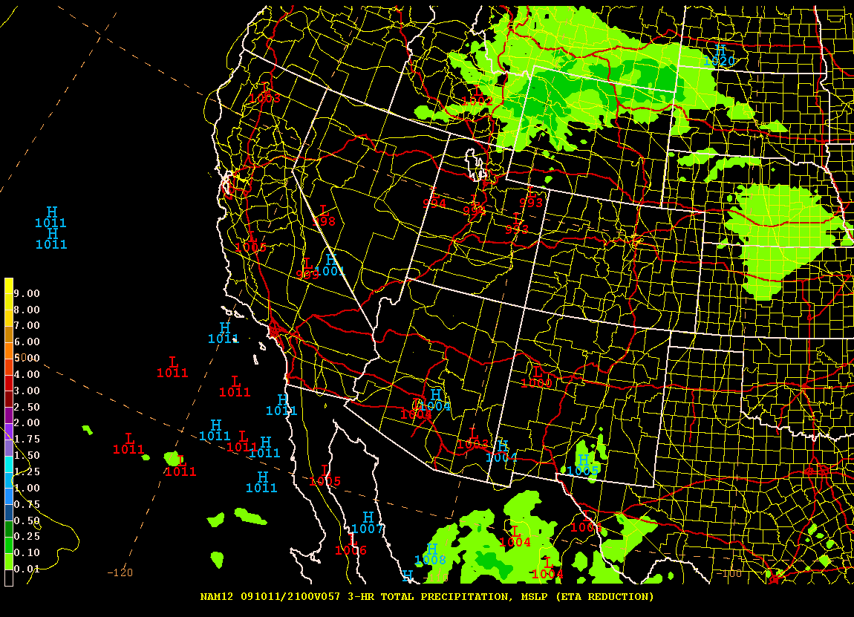
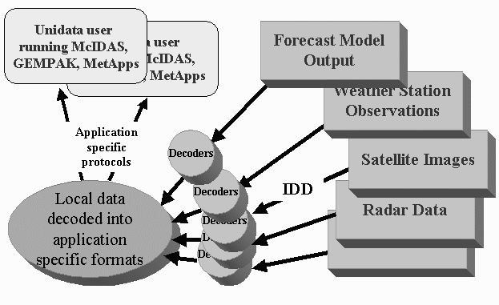
Advancing Earth System Science
NCAR’s Earth System Laboratory and the wider scientific community look to Unidata for data and tools that advance Earth System Science. Among the assists here:
Unidata’s real-time weather observations aid WRF forecasts
Used worldwide, netCDF lets researchers manage and use large data sets, such the CCSM AR4 climate runs
Visualization tools put perspective on little seen regions of the atmosphere, such as the UTLS.
NCAR’s Four Focus Areas:
Advancing Earth System Science

Slide 11
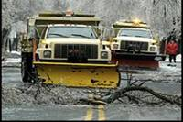
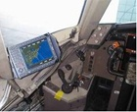
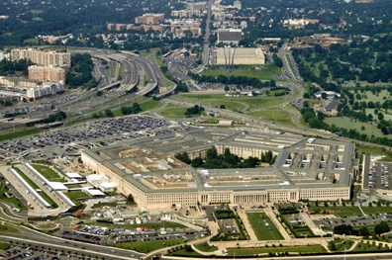
Technology Transfer for Societal Benefit
One of Unidata’s largest data beneficiaries, NCAR’s Research Applications Laboratory feeds Unidata information into many of the tools and programs that serve society – from its roadway decision-support systems, to aviation efforts that make commercial flying safer, to its many, varied national security applications.
NCAR’s Four Focus Areas:
Technology Transfer for Societal Benefit

Slide 12
One Conclusion
Unidata touches every aspect of NCAR’s mission

Slide 13
Thank you. NCAR Celebrates 25 Years of…
Close partnerships and strong ties between Unidata and NCAR Labs, Divisions and Groups
Seamless NCAR-Unidata collaboration that occurs at all levels – from management to staff
the benefits that accrue to NCAR, UCAR and the wider science community that we serve.

Slide 14
Thank you

